Slide 1

Group E Project 1
Shannan Sharp
Tommy Smith

Slide 2
Music Patterns from 2010-2019
Analysis based on database of songs from Spotify
https://www.kaggle.com/leonardopena/top-spotify-songs-from-20102019-by-year
What were the trends through the years?
What was the most popular genre overall? Each year?
Who was the most popular artist overall? Each year?
Looking at a unique analysis
How do beats per minute correlate to “dancibilty”?

Slide 3
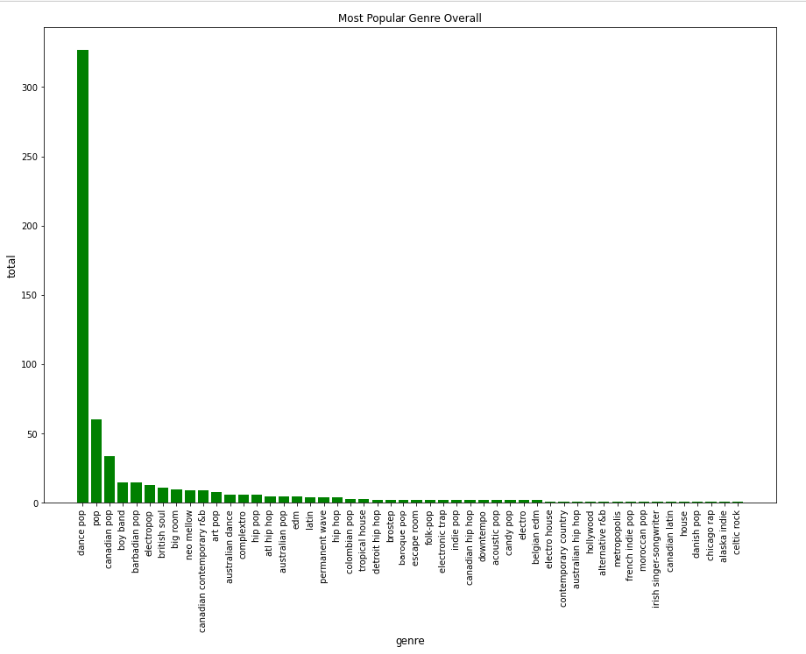
Most Popular Genre Overall

Slide 4
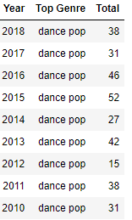
No Surprise, but Dance Pop Was Most Popular Each Year

Slide 5
Most Popular Artist Overall

Slide 6
Most Popular Artist by Year

Slide 7
Statistical Analysis of Beats Per Minutebpm
 | bpm
count | 603.000000
mean | 118.545605
std | 24.795358
min | 0.000000
25% | 100.000000
50% | 120.000000
75% | 129.000000
max | 206.00000

